Slide 1
Master Slide Deck
Leveraging Rancher Federal within the U.S. Government/Public Sector
Zack Brady – Field Engineer zack.brady@ranchergovernment.com
CAGE Code: 8GLZ3
DUNS: 117387835

Slide 2

Introductions / Overview
What’s a Container? Kubernetes?
Why Rancher Federal
Open-Source Ecosystem
The Rancher Federal Approach
Rancher Government Carbide
Demo / Workshop (my favorite)
Today’s Agenda
Notes:
2

Slide 3

About Me…
DoD/IC Contractor
U.S. Military Veteran
Built/Exited a Digital Firm
Open-Source Contributor
Career of Software/DevOps
Active Volunteer FF/EMT
Zack Brady – Field Engineer zack.brady@rancherfederal.com
https://linkedin.com/io/zackbradys

Slide 4
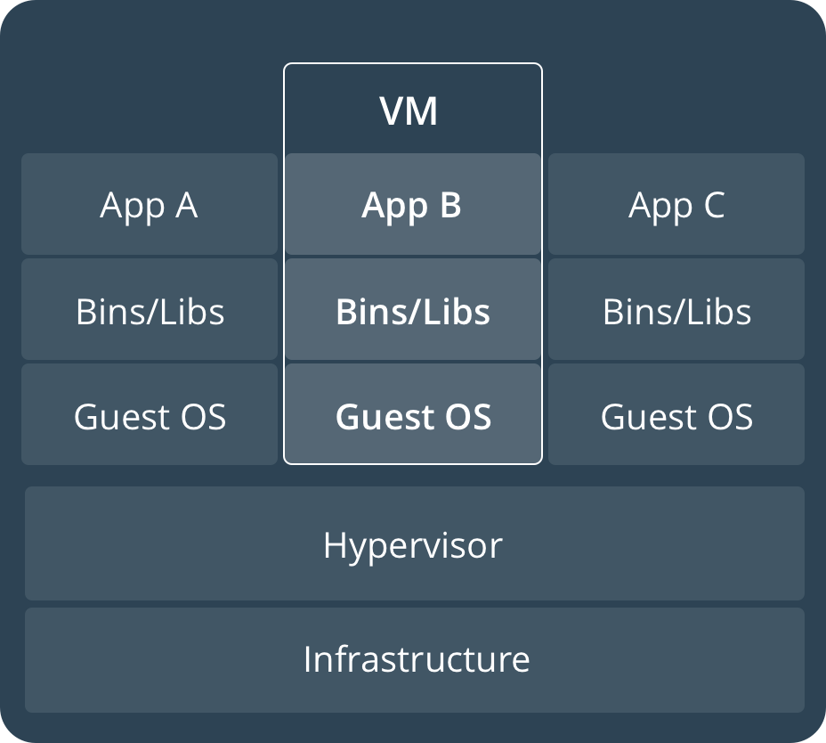
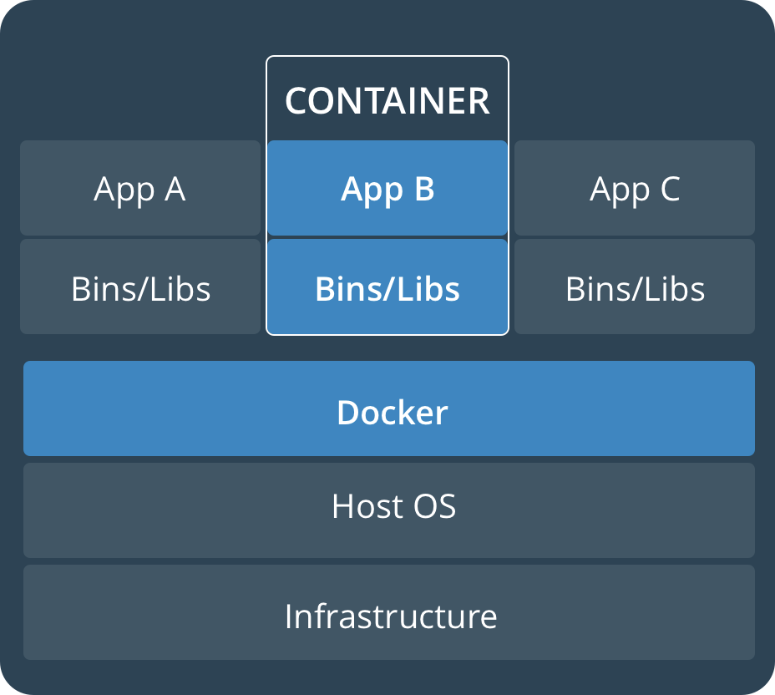
Virtual Machines vs Containers
Notes:
4

Slide 5
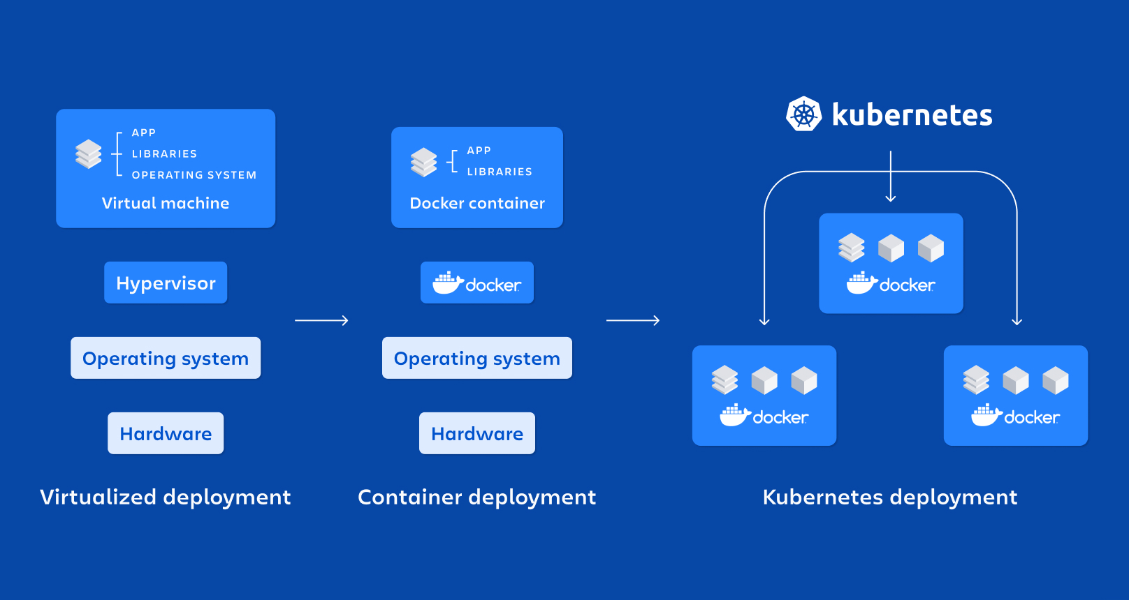
VMs -> Containers -> Kubernetes!
Notes:
5

Slide 6

Rancher Government Solutions (RGS)
Engineering Cloud Native Computing Platforms for the US Government
Rancher Government Solutions (RGS) is a 100% US-based entity dedicated to delivering Kubernetes and Cloud Native Technology solutions, services, and support across the U.S. Government including the Federal Government, Department of Defense, and Intelligence Community.
Rancher Government Solutions (RGS) offers varying levels of service including US-State Side Support and cleared on-site support and exists to enhance Rancher’s capabilities to meet the ever-evolving government mission requirements.
STIG/CIS Hardening & Validation
SELinux and FIPS-2/3 Compliance
Air-Gapped , W&S, C2S, SC2S, GovCloud Support
Enterprise Audit Functionality
RBAC and PKI Authentication
Notes:
6

Slide 7



Rancher’s Three Pillars of Success
Accelerating Mission and Driving Success for our Customers
Enterprise Support
Professional Services
Mission - Accelerator
24/7/365 U.S./CONUS based Enterprise Support for Rancher and the Kubernetes Ecosystem.
Technical Account Manager and Bootstrap Architecture Support
Cleared Onsite Engineers and Support Teams
70% of RGS hold a TS//SCI or higher clearance
Continuous Training & Education
On-Site, On-Premises, or Remote Cleared Engineers
Cloud-native Advocates and Evangelists focused on bootstrapping or delivering customer success
Multiple Prime Contracts at USAF PlatformOne and many Subcontracts across the DoD/IC Communities
Ranges from Hands On Support to Quarterly Meetings
Dedicated to weaponizing the Rancher products to work better in airgap/offline/classified mission environments
Bringing a security-first mindset to the Rancher capabilities by baking in NIST FIPS-140-2/3 encryption & DISA STIG certification/validation
Collaborated to develop the RKE Government/RKE2 secure-by-default Kubernetes distribution
Notes:
7

Slide 8

















Worried about STIGs? Concerns with ATOs?
8

Slide 9

Customer Success Stories
Bleeding-edge technology advancing the mission landscape tomorrow
CDC Operation WARPSPEED
USAF Platform-One
U2 Federal Laboratory
(Customer Problem) The U2 Spy Plane has been retrofitted with computational hardware running Rancher’s K3s distribution for cloud-native AI/ML in-flight
(Rancher Federal Solution) Rancher Federal Engineers executed a ‘get-well’ strategy enabling the U2 Fed-lab to modernize a 60-plane into a foundational platform for a modern-day mission weapons platform
(Customer Problem) Platform Engineering contract focused on a ‘Get Well Strategy’ to modernize the CDC’s immunization data lake infrastructure
(Rancher Federal Solution) Rancher Federal Support and Consulting Engineers introduced a hybrid-cloud architecture that migrated CDC workloads from pure AWS -> AWS, Azure, and On-Prem Bare Metal
2 Prime contracts with USAF P1 with 18 FTEs supporting the DevSecOps initiatives and platform infrastructure.
70% of P1 Kubernetes clusters are running Rancher’s RKE2 distribution
Rancher’s k3s distro is shipping on a USAF Edge-One satellite mission in CY2021.
Direct Support: ABMS, F35, INSCOM
C-ATO Approval
Notes:
9

Slide 10












Products and Projects
RANCHER
Flagship product – Rancher Multi-cluster Manager is world’s most popular Kubernetes Management platform
A CNCF-certified Kubernetes distribution that built to the security requirements of the DoD/IC
A CNCF-certified, Lightweight Kubernetes distribution. Easy to install, half the memory, all in a binary less than 100MB
COMMERCIALLY SUPPORTED PRODUCTS
HARVESTER
Highly availablepersistent block storage for microservices-based, stateful applications
Kubevirt-powered Hyperconverged Infrastructure (HCI) for deploying traditional VMs on Kubernetes Coming Soon
GitOps & Continuous Delivery at scale. Deploy & manage thousands to millions of clusters at the network edge
OPEN SOURCE PROJECTS
Built to connect overlay networks of different Kubernetes clusters
10
Notes:
10

Slide 11

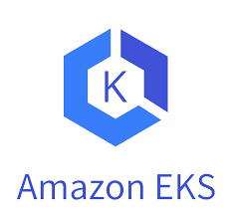
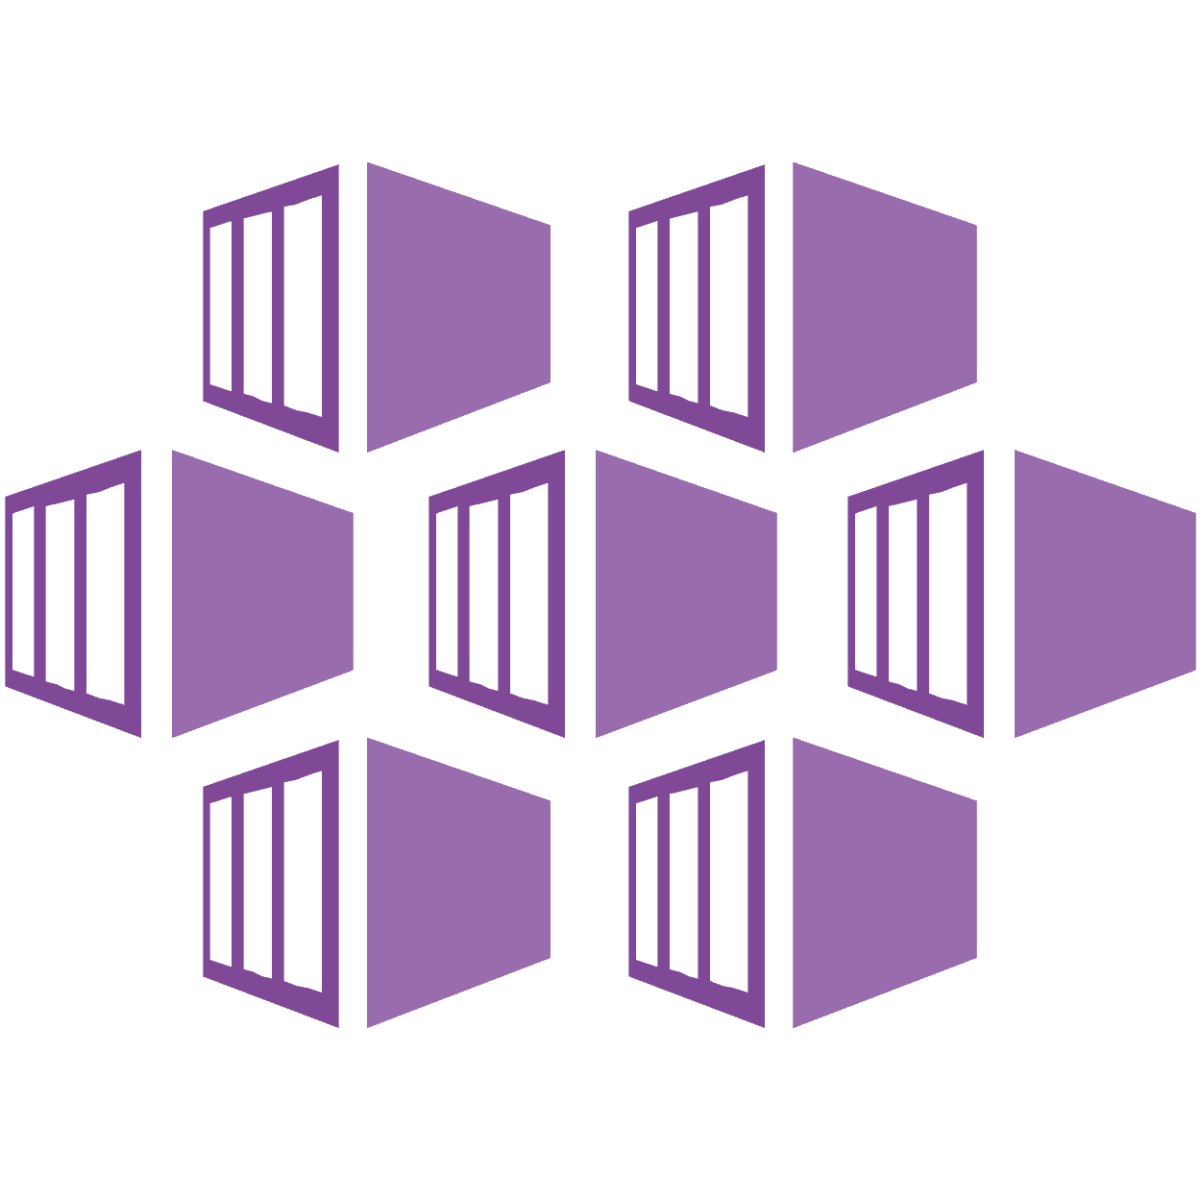









Rancher is Fully Open and Interoperable
Datacenter
Edge
Block Storage
Other Kubernetes Distros
Rancher
2
Azure AKS
Google GKE
Linux Distros
Hybrid Cloud Infrastructure
Notes:
11

Slide 12




















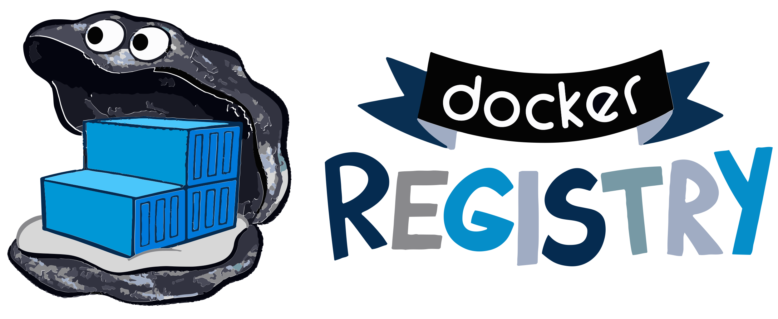











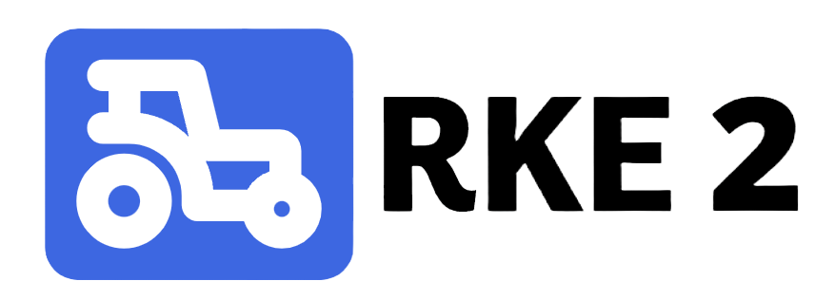










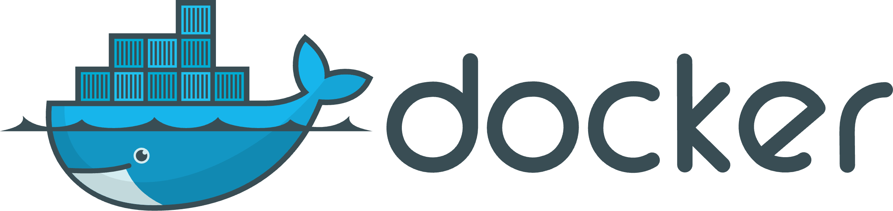









The Complete Rancher Stack
Rancher Government Solutions SLA
Certified Integrations
Authentication & Authorization
App Management & CI/CD
Monitoring & Logging
Registry & Image Scanning
Container Security & Secrets
Networking & Service Mesh
Platforms & Orchestration
GKE
AKS
Persistent Storage
Container Engine
Operating Systems
Infrastructure Drivers
12
Notes:
12

Slide 13
Rancher Federal + Amazon AWS
Rancher is the leading Kubernetes distribution and Kubernetes platform.
Amazon AWS is the leading and most adopted cloud provider.
But what does that mean for our customers?
Rancher Federal and Amazon AWS have partnered together to develop public AWS Marketplace offerings to dramatically reduce the barrier to entry to Kubernetes management in the cloud.
These listings provide a free trial or fully supported deployment of a preconfigured highly available deployment of RKE2/Rancher Manager on AWS GovCloud (U.S.), designed strictly for use only by U.S. Federal Government and Public Sector Customers.
https://tryranchergov.com
https://github.com/zackbradys/rancher-on-aws
13

Slide 14
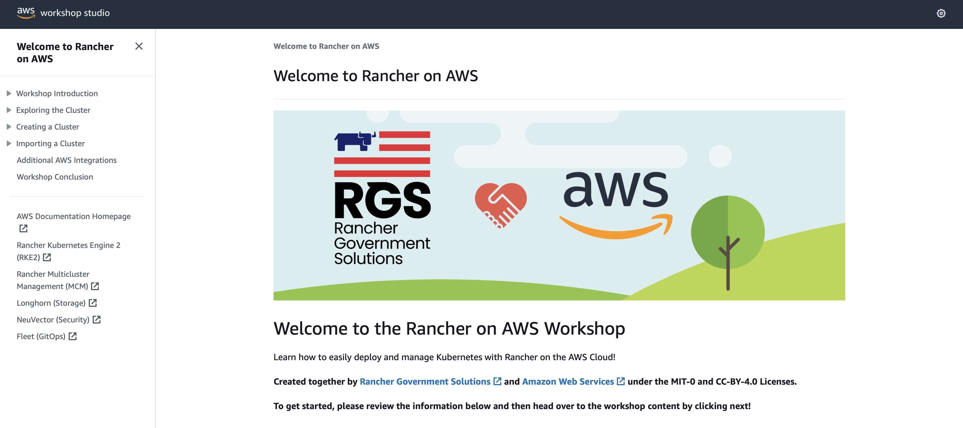
Rancher on AWS Workshop
Learn how to easily deploy and manage Kubernetes with Rancher on AWS! https://catalog.workshops.aws/rancher
14

Slide 15

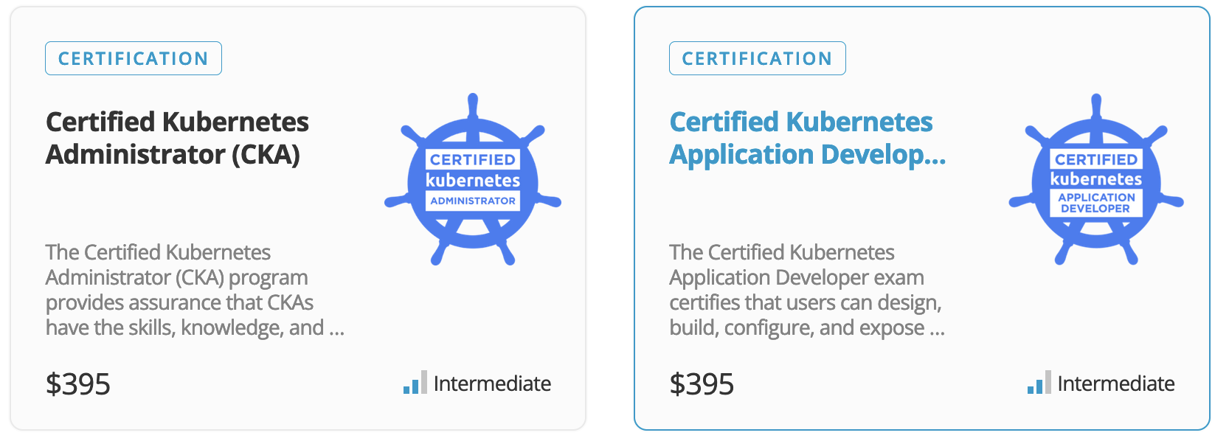
Included Enablement and Training Paths
The Linux Foundation is non-profit designed to build sustainable ecosystems around open-source projects to accelerate technology development and commercial adoption.
Included with the Rancher Multi-Cluster Manager Subscription:
1 Year Subscription to the complete Linux Foundation eLearning Catalogue
1 Individual Linux Foundation Certification
Additional subscriptions available via the RGS-Linux Foundation Customer Portal

Slide 16
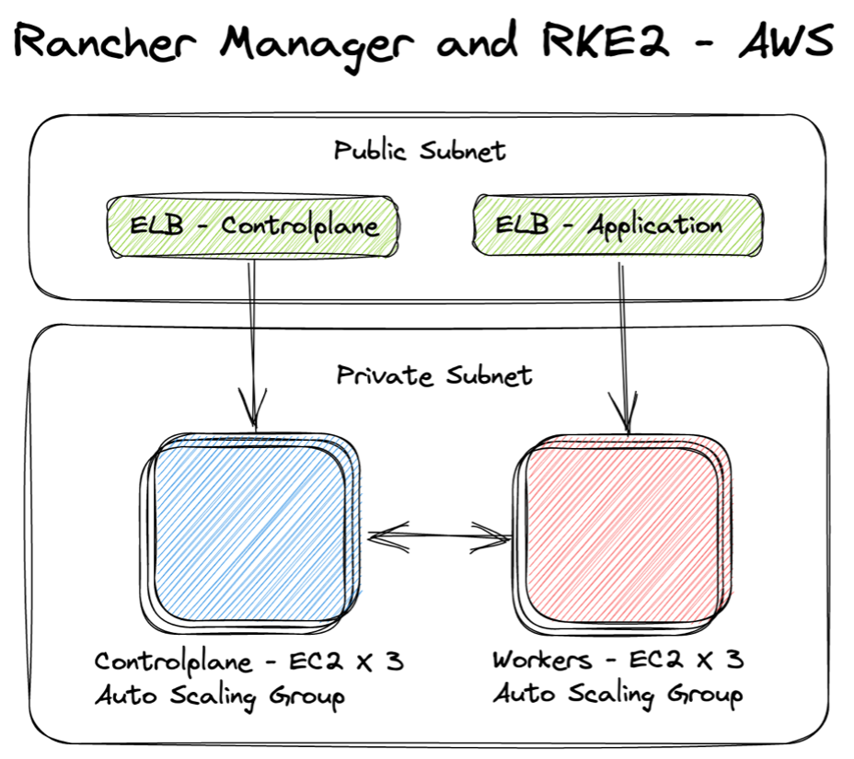
Architectural Overview
16

Slide 17
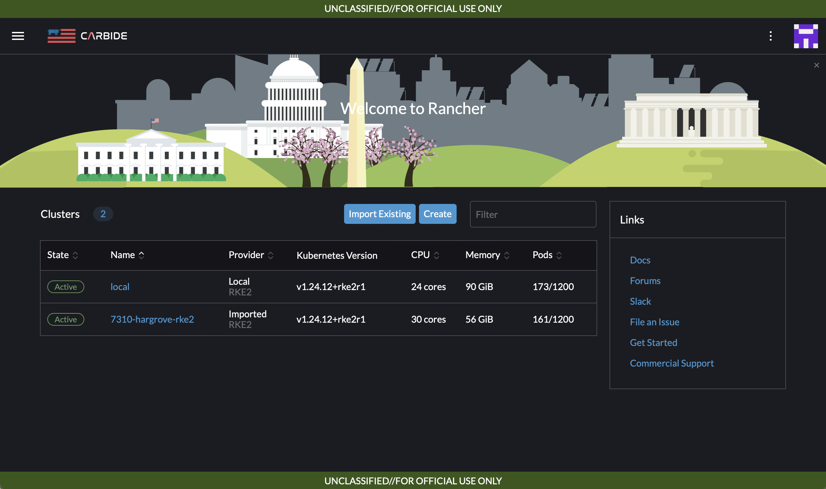
Rancher Government Carbide…
Available to all current and future supported customers!
Secure and Trusted Container Registry (Azure Gov)
Government STIG Validation (STIGATRON)
Supply Chain Management Offline Rancher Docs
SLSA3/SBOMs/Scans
Built for our U.S. Government Support Customers (Licensed)
RGS Answer to E.O. 14028

Slide 18
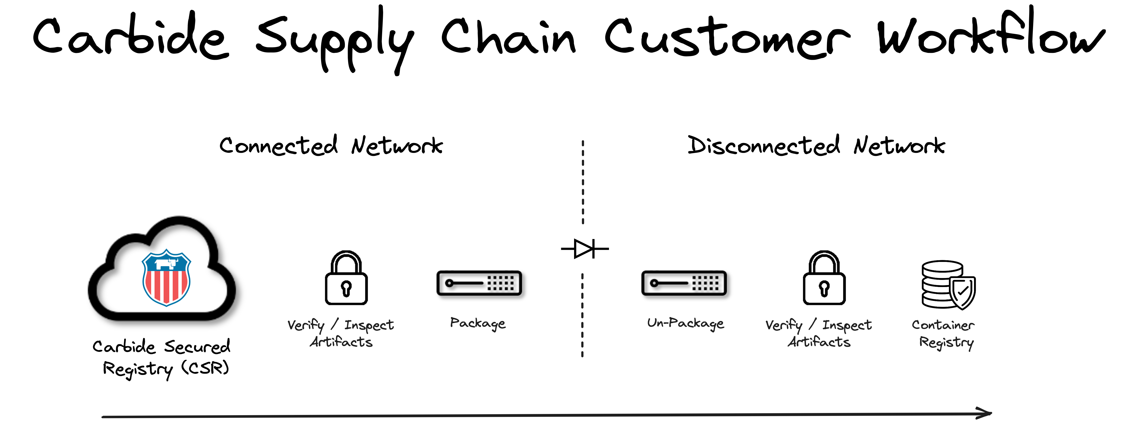

Notes:
Deeper dive into secure software pipeline flow

Slide 19
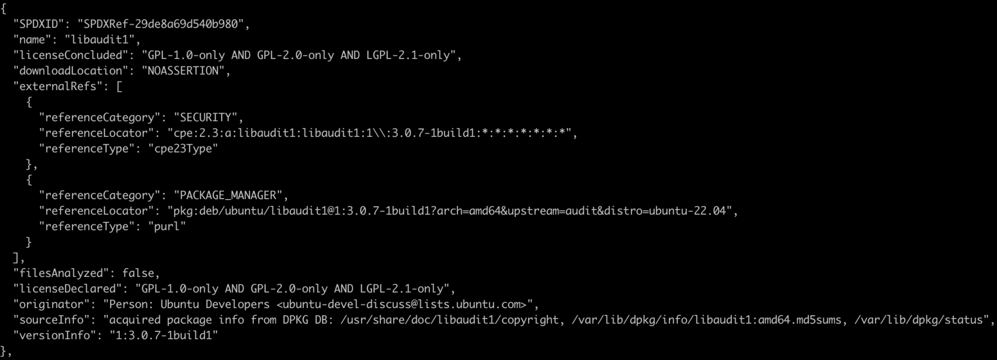
Software Bill of Materials
19

Slide 20
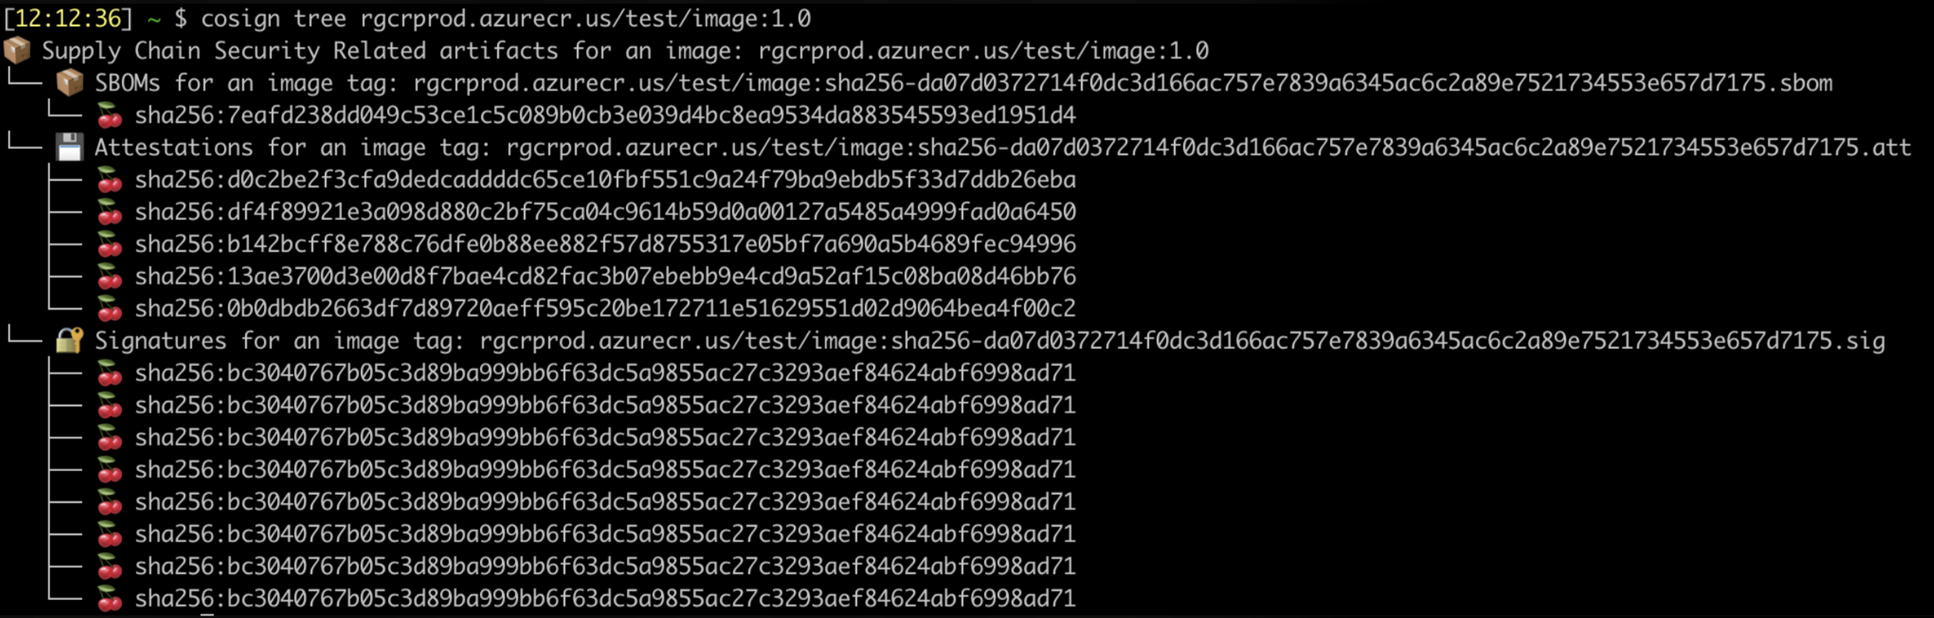
Image Attestation Reports
20

Slide 21
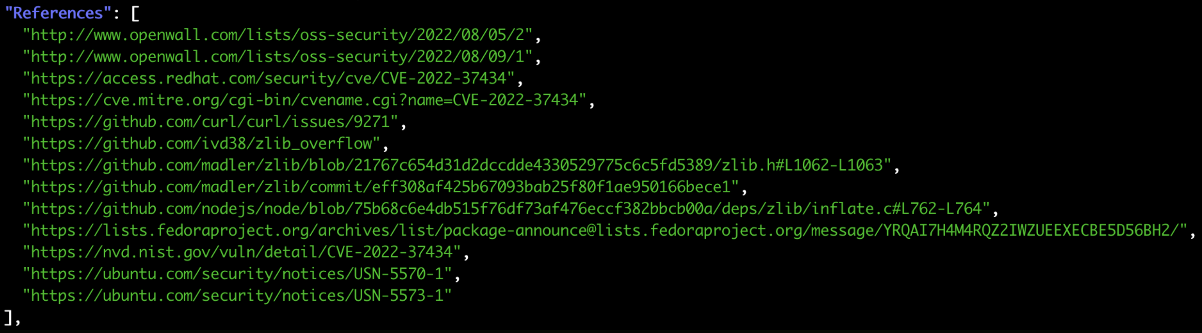
Image Vulnerability Scans
21

Slide 22

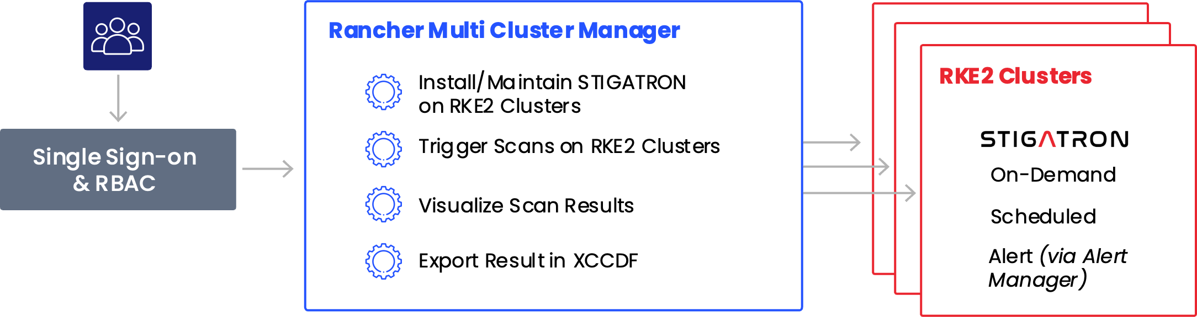
Validate downstream clusters compliance from the centralized Rancher Manager
Monitor
Empower
Streamline
and validate the DISA STIG integrity of downstream RKE2 Kubernetes clusters
system administrators to refocus their time on more meaningful initiatives
cyber auditing and compliance processes
Notes:
Deeper dive into STIGATRON

Slide 23
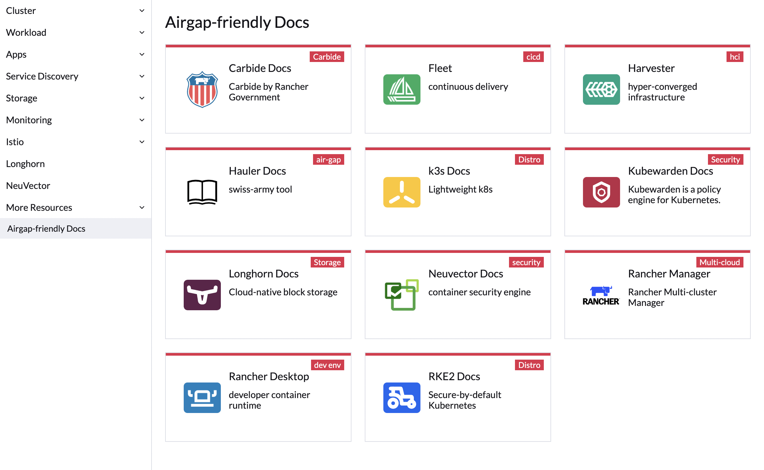
Rancher Offline Docs
23

Slide 24
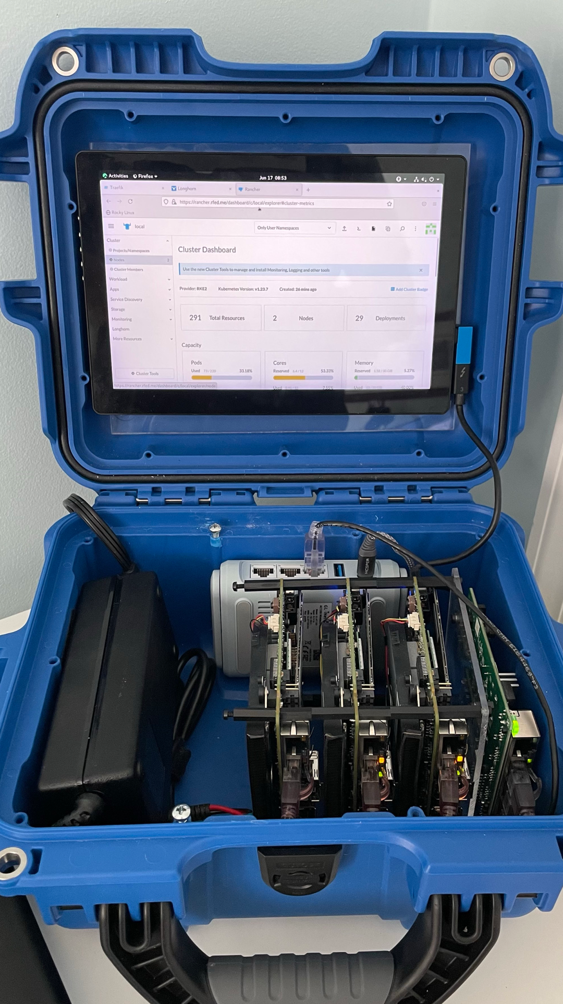
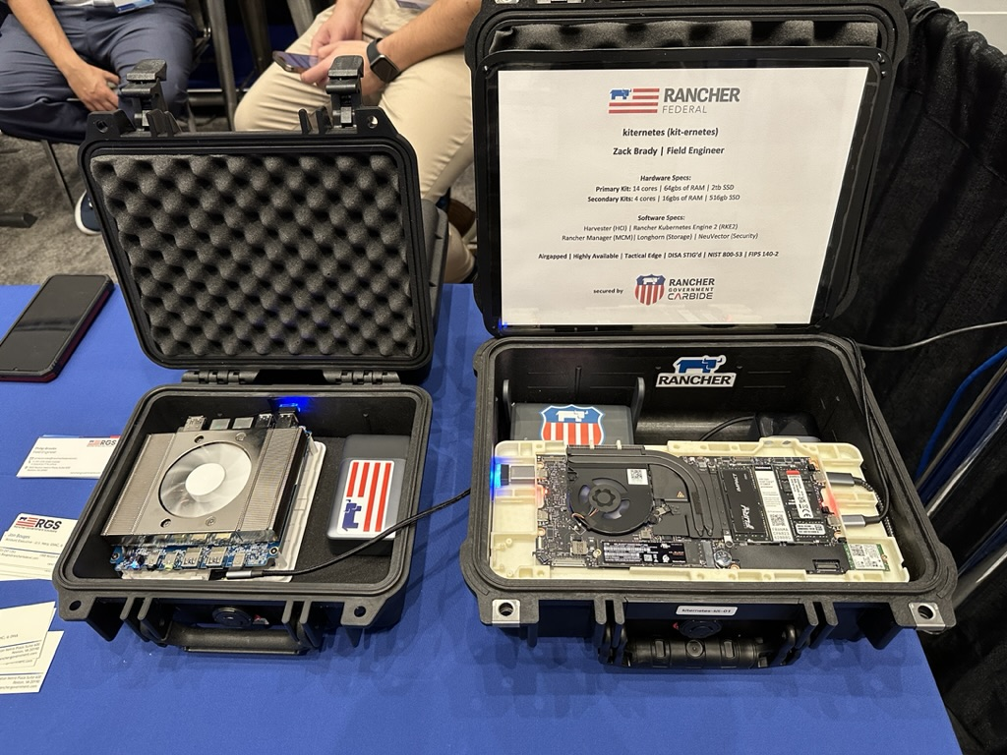
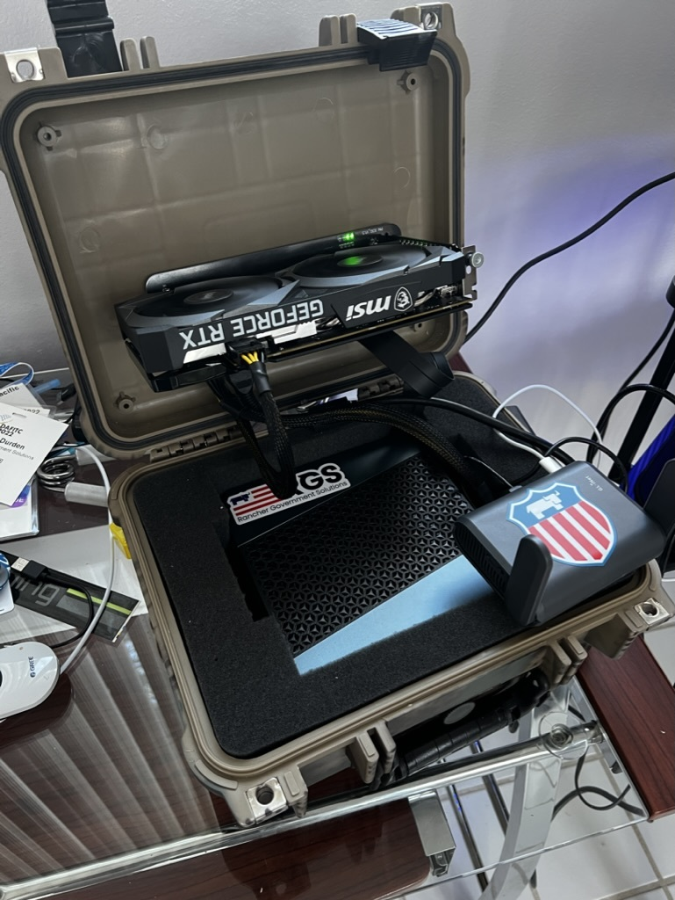
From Datacenters to the Edge…
24

Slide 25
Questions?
and then our…
Technical Workshop!
http://workshop.rancherfederal.io

Slide 26
Thank you for your time today!
Email: zack.brady@rancherfederal.com
GitHub: https://github.com/zackbradys
Website: https://ranchergovernment.com
Cage Code: 8GLZ3
DUNS: 117387835

Slide 27















Rancher is always Meeting You At Your Mission
Platform Services
Security
Developer Services
- Multi-Cluster & Multi-Cloud Kubernetes Management
Authentication
App Catalog, Observability, Storage & Networking
App Catalog
Monitoring & Alerts
Persistent Storage
Service Mesh
Application Deployment
Compliance & SUSE Linux Scans
Policy Enforcement & Governance
Local Development
LDAP
Centralized Audit & CIS Benchmarking
AIOps, Monitoring & Logging
RBAC, Pod & Network Policies
OPA & KubeWarden
Pipeline Security Automation
Simplified Cluster Operations & Infrastructure Management
Container Image
Cluster Provisioning & Lifecycle Management
K8S Versioning & GitOps CD
Cluster Templates & Config Enforcement
Rancher Hosted
Virtual Machine & OS Management
SLE BCI
Zero-Trust Controls & File Protection
Infrastructure Services
1 & 2
Any CNCF K8s
Advanced Network Security
Amazon
EKS
Azure
AKS
Google
GKE
SLE Micro
Servers
Containers
VM
IaaS
CaaS
Servers
Device
VM
Automated Protection Modes
On-prem
Cloud
Edge
27
Notes:
27

Slide 28
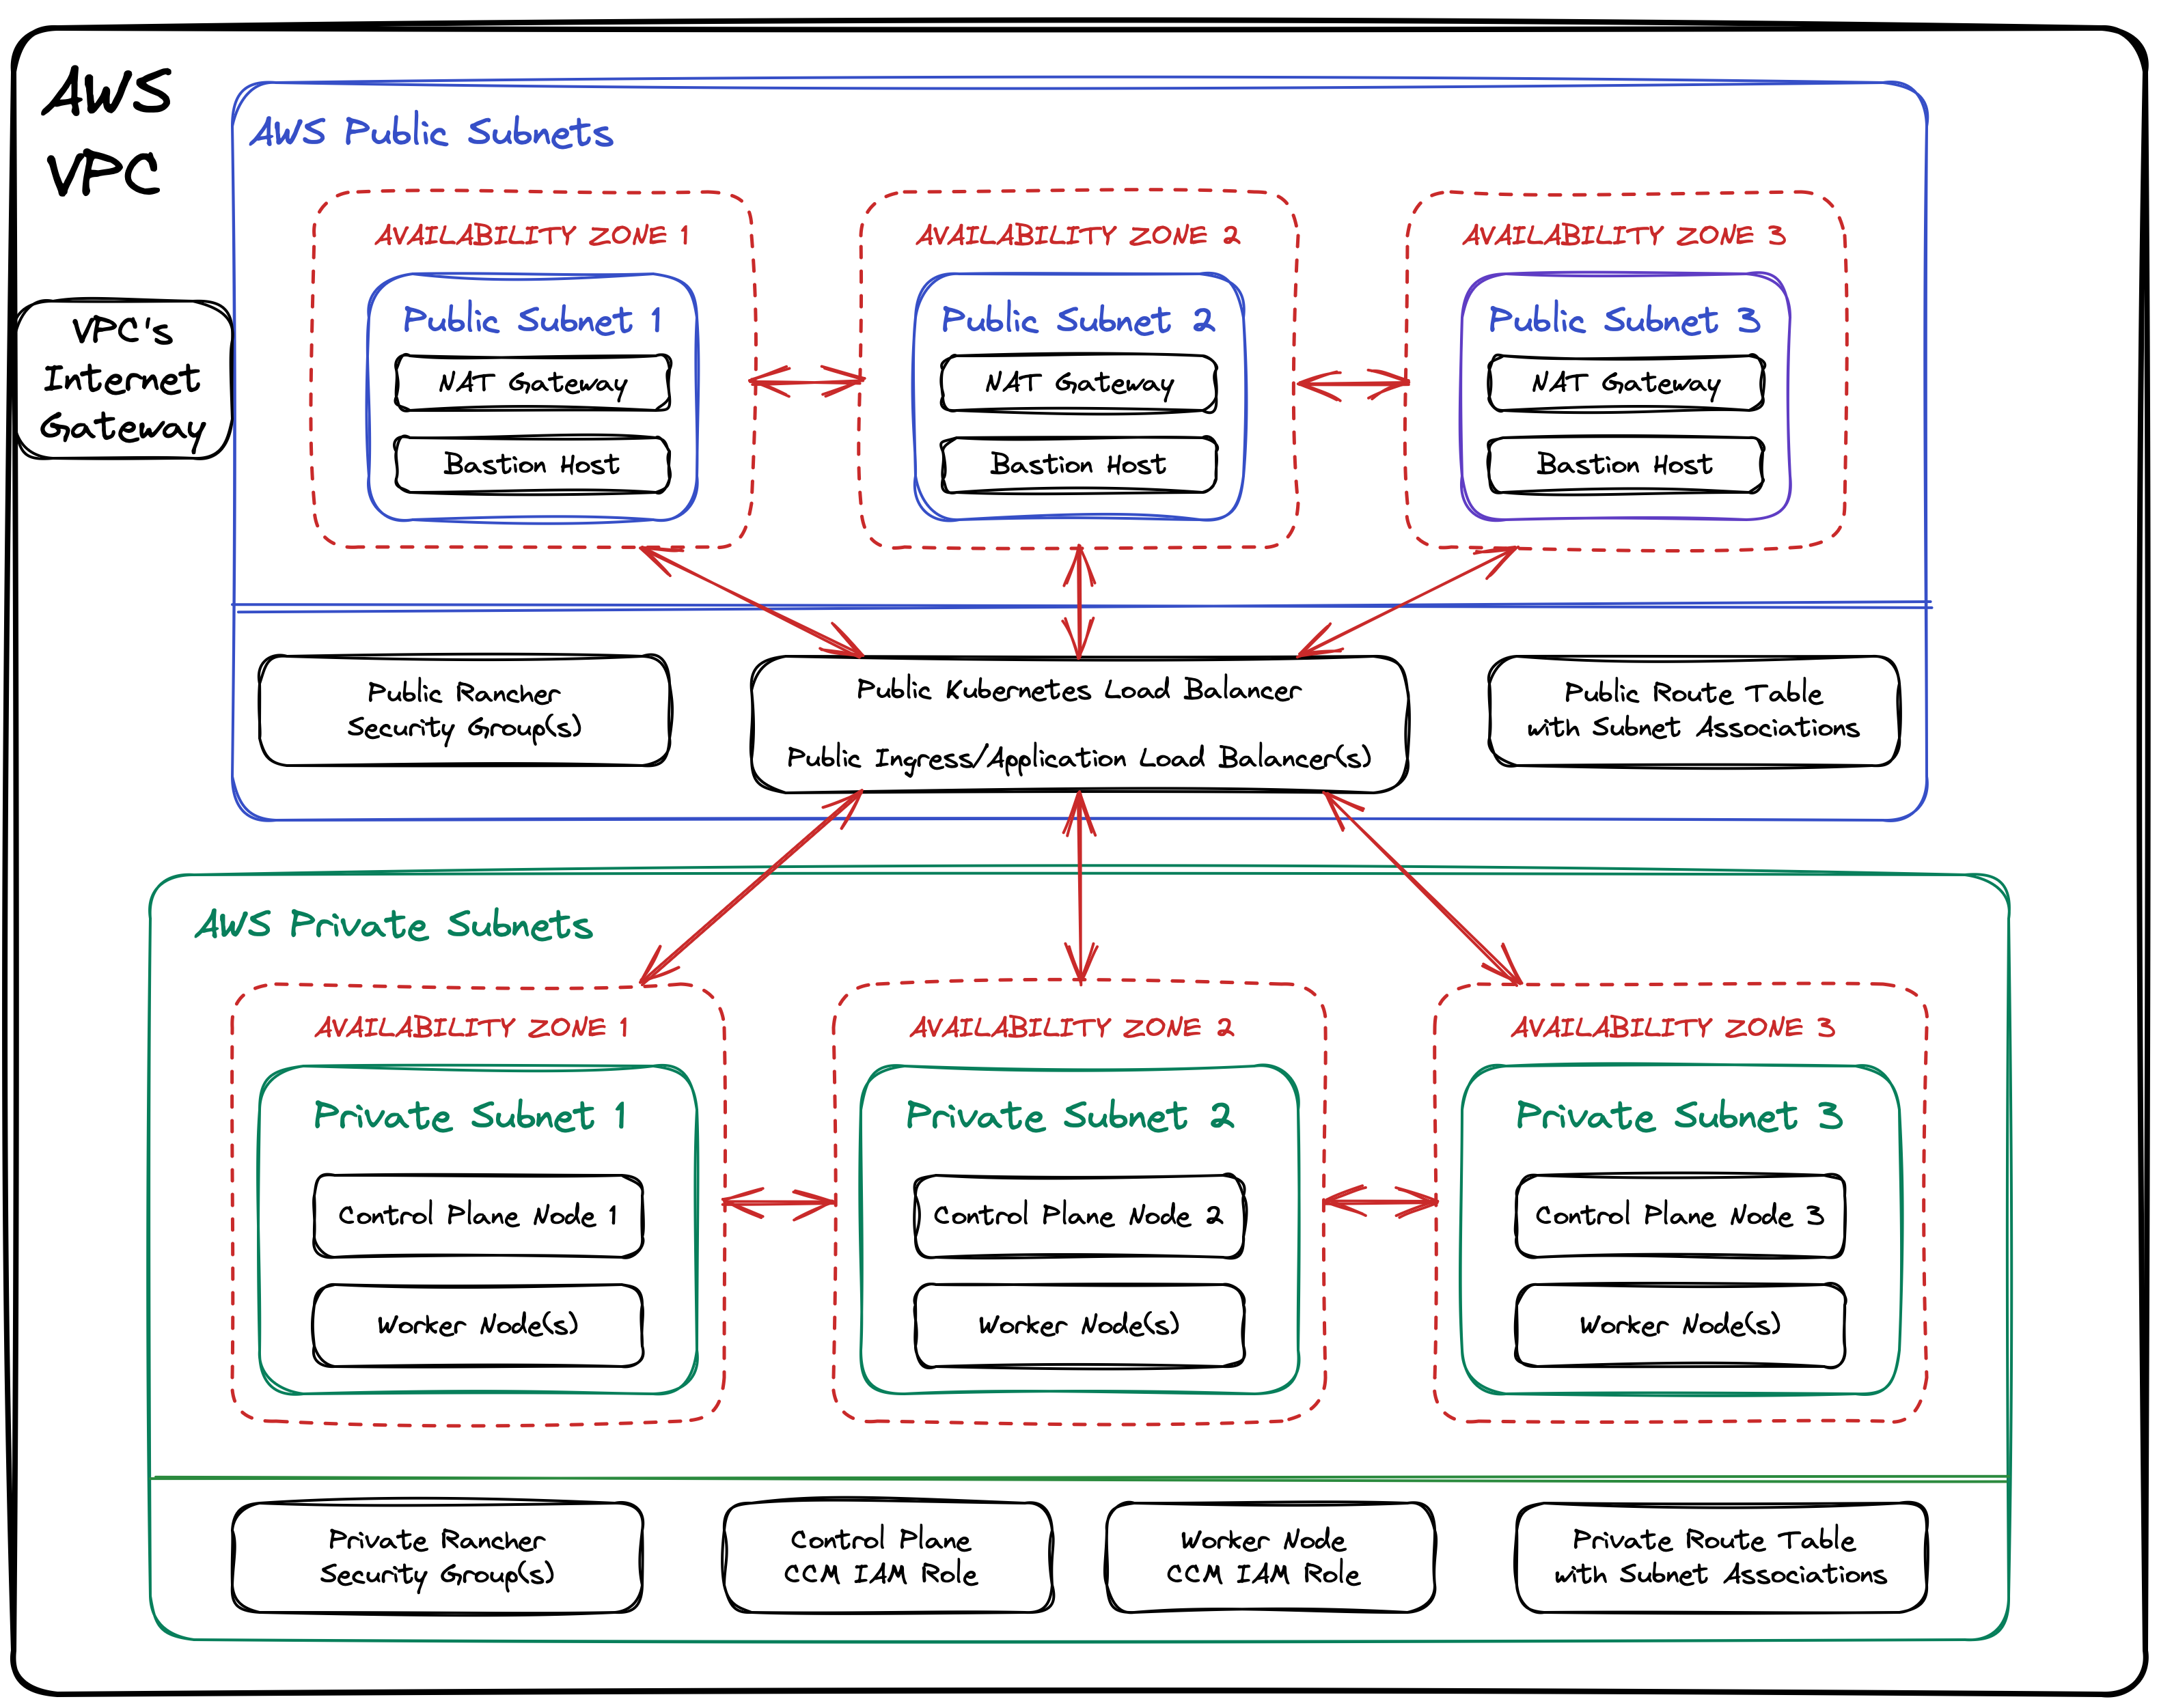

Slide 29
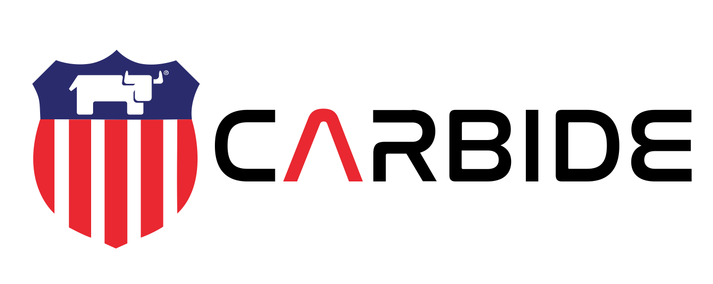
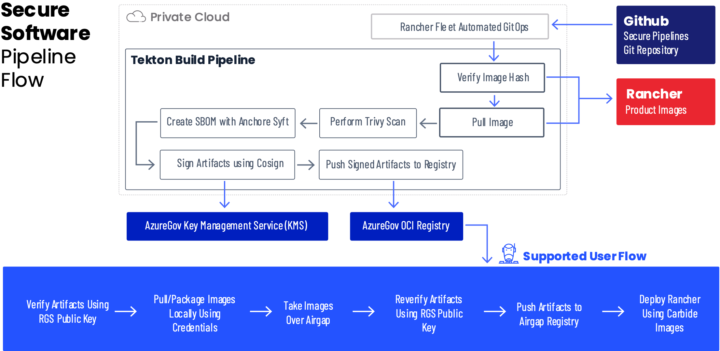
Carbide Supply Chain Security
Enabled by the Rancher Government Carbide Secured Registry (CSR)
Notes:
Deeper dive into secure software pipeline flow

Slide 30




Recommended Architecture
Rancher Management Server Cluster
Rancher Management Server Cluster
Highly Available
Node
Node
Node
Production Environment
Additional Environments
Highly Available
Node
Node
Node
(cp/etcd/worker)
(cp/etcd/worker)
Cluster 1 (Prod)
Cluster 2 (Prod)
Cluster 1 (Dev/Test)
Cluster 2 (Dev/Test)
Control Plane
Node
Node
Control Plane
Node
Node
Control Plane
Node
Node
Control Plane
Node
Node
etcd
Node
Node
Node
etcd
Node
Node
Node
etcd
Node
Node
Node
etcd
Node
Node
Node
Worker
Node
Node
Node
Worker
Node
Node
Node
Worker
Node
Node
Node
Node
Worker
Node
Node
Node
Node
Cluster 3 - Hosted (Prod)
Control Plane
Node
Node
Cloud Hosted Environment on GKE, EKS, AKS, etc
The Rancher Management Server cluster manages all downstream k8s. The k8s required to run Rancher are not counted in the downstream Rancher host count
etcd
Node
Node
Node
Rancher hosts are the downstream Kubernetes compute nodes managed by the Rancher Management Server cluster
Worker
Node
Node
Node
Node
Longhorn storage nodes managed by Rancher management server
No cost
30

